Slide 1
PEGA Decisioning Essentials

Slide 2
Agenda – Session 8
Predictions

Slide 3
Models
Models are AI learning models which are monitored and controlled in the prediction studio
Which provide the below types of models.
Predictions
In this work area, you can create predictions by answering several questions about what you want to predict. You can also access
, manage, and run existing predictions withing your application.
For more information about predictions, see Anticipating customer behavior and business events by using predictions.

Slide 4
Prediction Studio
Models
In this work area, you can access, sort, and manage predictive, adaptive, and text analytics models within your application. By default,
the models are displayed as tiles. Each model tile contains an icon for quick identification of model type, the model name, and the indication of whether the model is completed or being built.
Data
In this work area, you can create and manage data sets or Interaction History summaries. In addition, you can access resources such as taxonomies or sentiment lexicons that provide features for building machine-learning models.
Settings
This work area contains the global settings for model development, such as the internal database where model records and related
resources are stored, their default application context, and model transparency policy.

Slide 5
Types of Models
Predictions - Create Predictions By Answering Set of Questions. Can create using Historical Data and Without Historical Data
Adaptive Models - These are Self-Learning Models that learn from the interaction history mainly gathering information from Adaptive Analytics Service.
Predictive Models - These require historical data and predictors inorder to provide decisions but better and accurate compared to adaptive models
Text Analysis –
Used to extract, analyse and output text related data and provide valuable insights to the business.

Slide 6
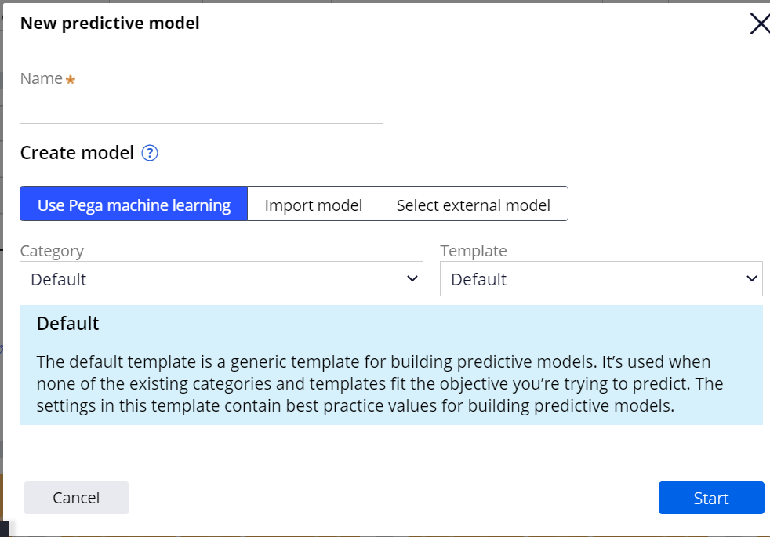
Predictive Models
Predictive analytics predict customer behavior, such as the propensity of a customer to take up an offer or to cancel a subscription (churn), or the probability of a customer defaulting on a personal loan.
These Models do require previous customer interaction data in order to apply the machine learning techniques

Slide 7
Predictive Models
Predictive analytics predict customer behavior, such as the propensity of a customer to take up an offer or to cancel a subscription (churn), or the probability of a customer defaulting on a personal loan (Credit risk)
For example. A Customer who recently lost a job who is having an active personal loan, the business can apply predictive models to understand the risk of defaulting the loan. Hence the predictive models require the customer data and their interactions.

Slide 8
Predictions
Create predictions to anticipate business events and customer behavior, such as or the probability of a customer accepting an offer. We can use it in strategy.
With Historical Data -
Learn based on the customer previous history and interaction data. i.e the Outcomes of previous customer interactions.
Without Historical Data –
Learn based on the predictors selected as well as the answering to set of questions.
2 Types of Predictors
Numeric – All Numeric fields
Categorical – All Non Numeric Fields.

Slide 9
Adaptive Model Generation
For Every Prediction created without historical data, an adaptive model rule is also generated.
Since, these are predictions without historical data, adaptive models are generated so that they can learn and later we can directly use the adaptive model within the strategy.

Slide 10
Using Predictions
Next we need to add the prediction shape to the strategy inorder to make it learning and the adaptive model will be updated everytime u run the strategy.
For example:
To determine which of your phones a customer is most likely to buy, connect the Phones Proposition Data shape to the PredictCustomerAcceptance Prediction shape.
Result –
The Prediction shape returns a propensity score .pyPropensity for each source element. Notice all propensity is 0.5 since we have no responses.
For example, a PredictCustomerAcceptance Prediction shape calculates the customer propensity to select each offer from the Phones Proposition Data shape.You can now select the top propensity offer by connecting the Prediction shape to a Prioritize shape

Slide 11
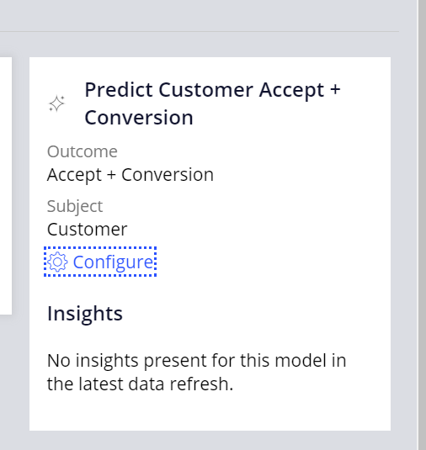
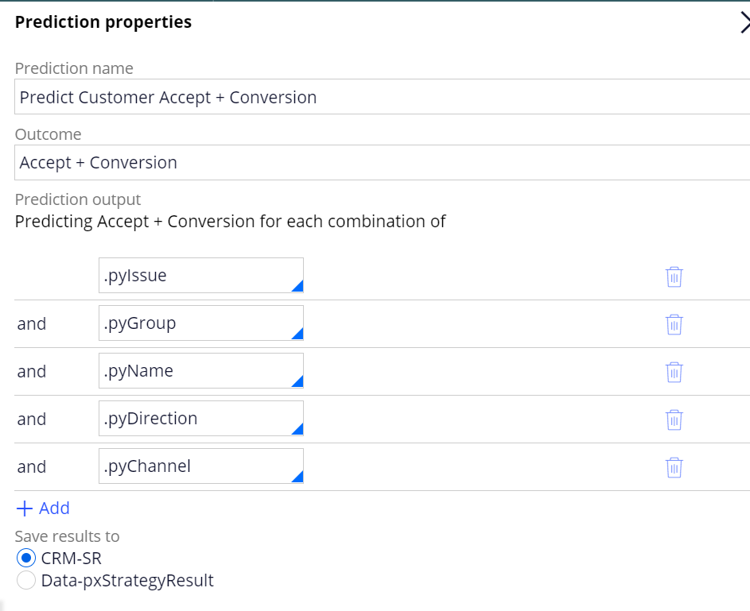
Updating Prediction
50% of Chances that the offer can be accepted when propensity is 0.5
We can update the prediction as we start receiving customer responses with the predictors that are having high performance rate and success rate from the adaptive model.
Navigate to prediction and add more predictors or delete unnecessary ones by clicking configure link.
Save results to your application SR Class.

Slide 12
Generated Rules
When we run a prediction, Below rules are created.
Adaptive Model
Prediction
Strategy
Adaptive Models are by default inactive unless having customer responses, Notice the monitor tab is empty. As customers respond, the model keeps learning
And shows the graph to analyse the response.

Slide 13
Unit Testing Prediction
Run the prediction standalone from three dots > run to test the prediction before using in strategy.
Select the data source as data set
Select a customer profile so that prediction runs on the profile analyses the predictors and generates the output
Since we got a prediction result i.e the propensity with output less than 0.5 which is low propensity.
We can try to modify the predictors by adding more relevant predictors or removing unnecessary prectors.s
As predictors are more important for prediction to get high propensity offers.

Slide 14
Questions!

